Slide 1


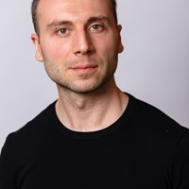




Speaker
Sergey Chubarov
Pentesting Azure Container Services
Sergey Chubarov
Sergey Chubarov
September 16th & 17th
^{Online Event}
Powered By
International Conference

